Slide 1
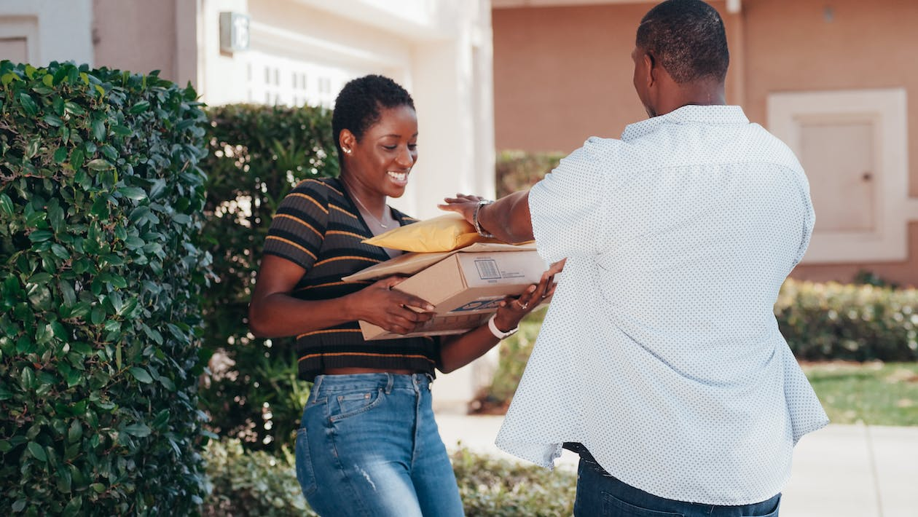

Business Analysis

Slide 2
Business overview
All customers | Total orders | Payment value | Total Reviews
99.44 K | 98.67 K | 16 M | 98.41 K
All sellers | Total items | Revenue | Review score
3.10 K | 112.65 K | 15.84 M | 4.08

Slide 3
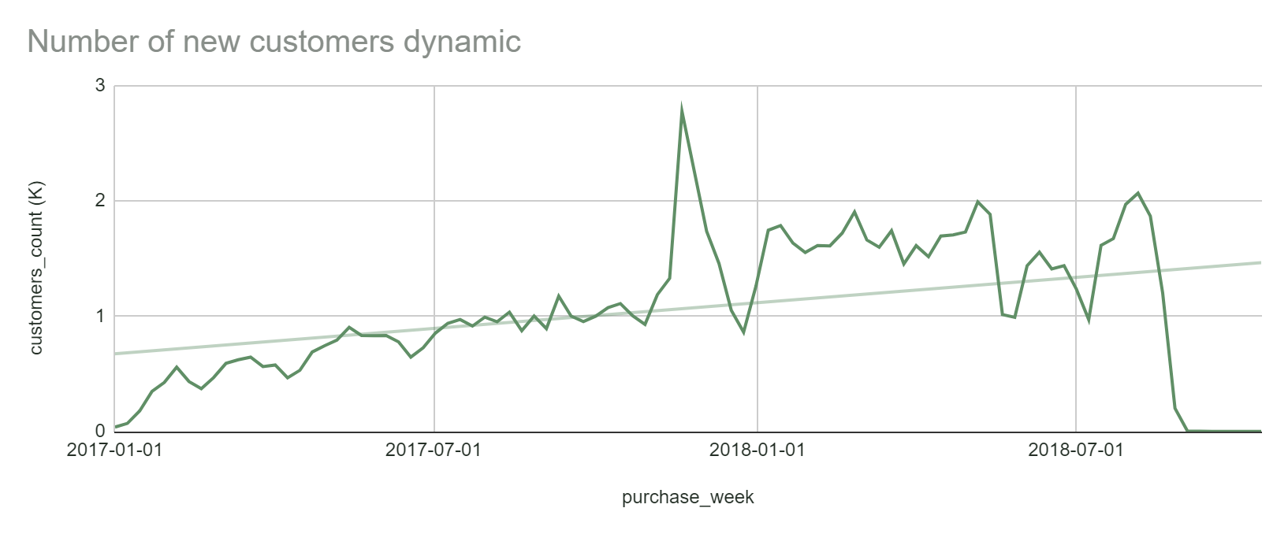
Growing tendency, with a high peak in 2017 Black Friday.

Slide 4
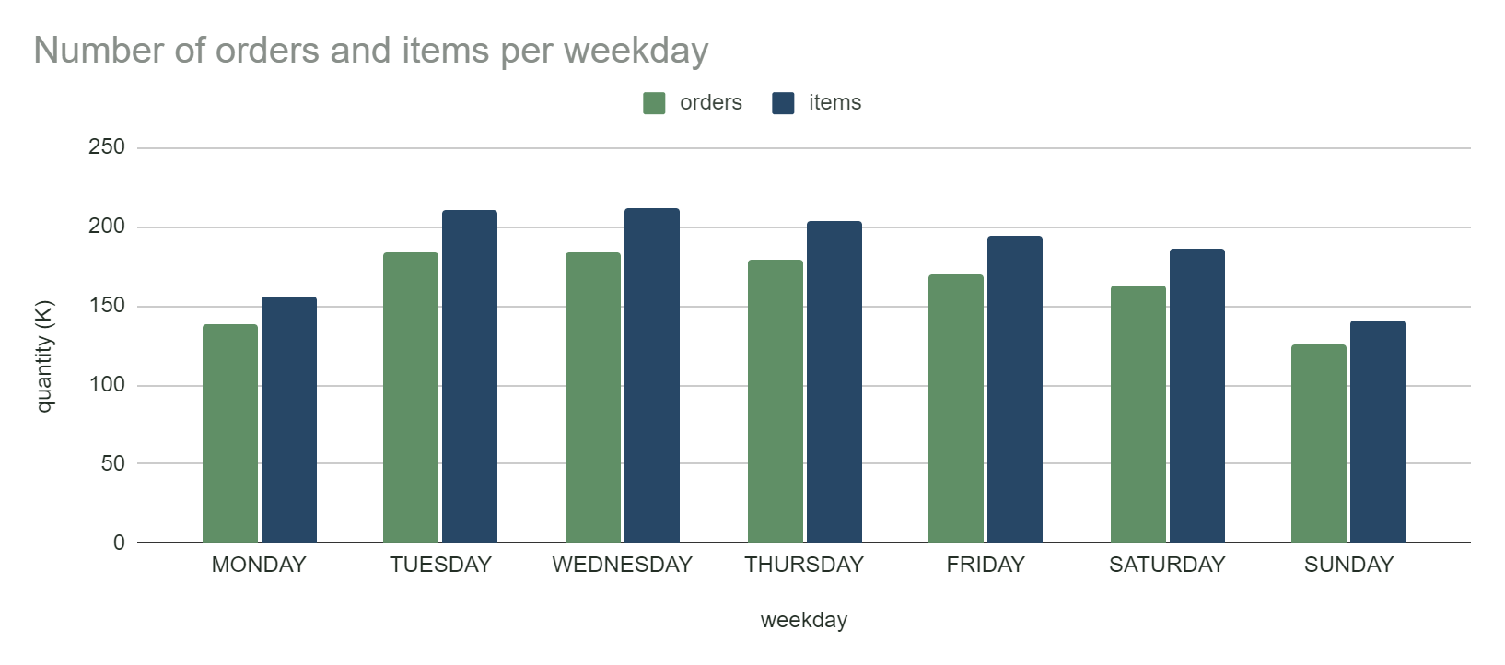
Higher tendency to buy more on Tuesday, Wednesday and Thursday.

Slide 5

Freight costs
Developing new strategy to lower the freight cost for customers.
Currently shipping cost depends on: product volume and product weight.
Recommended to offer higher discounts for bigger (in value) orders.

Slide 6
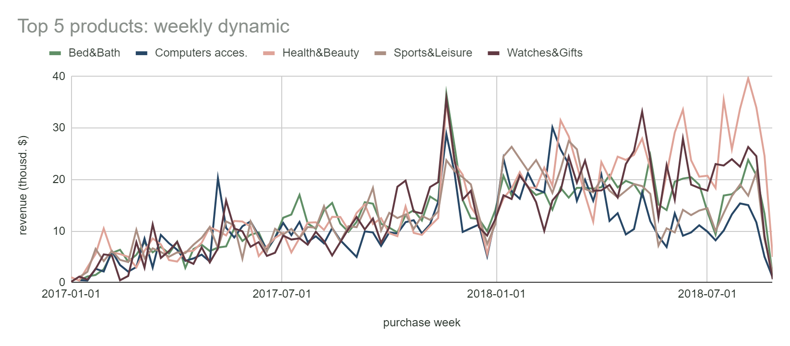
Top 5 product categories (by revenue) stay at the top throughout the year, and are well responding to Black Friday offers.

Slide 7
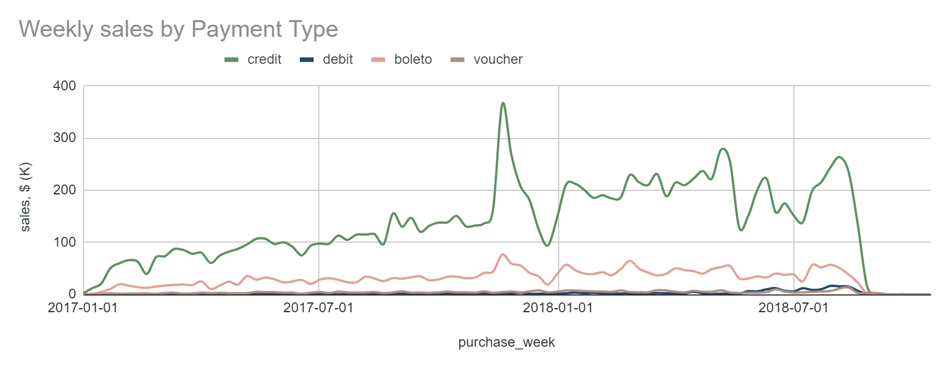
The most popular payment type is credit cards, presumably due to option to pay with many installments.

Slide 8
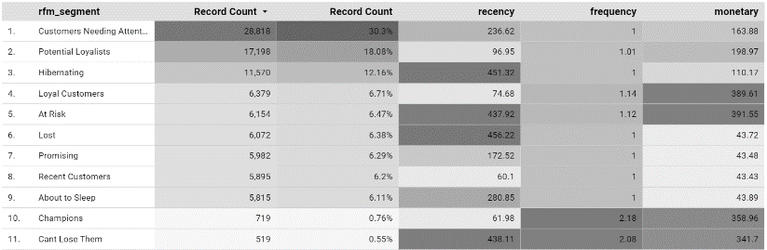
Customers overview

Slide 9
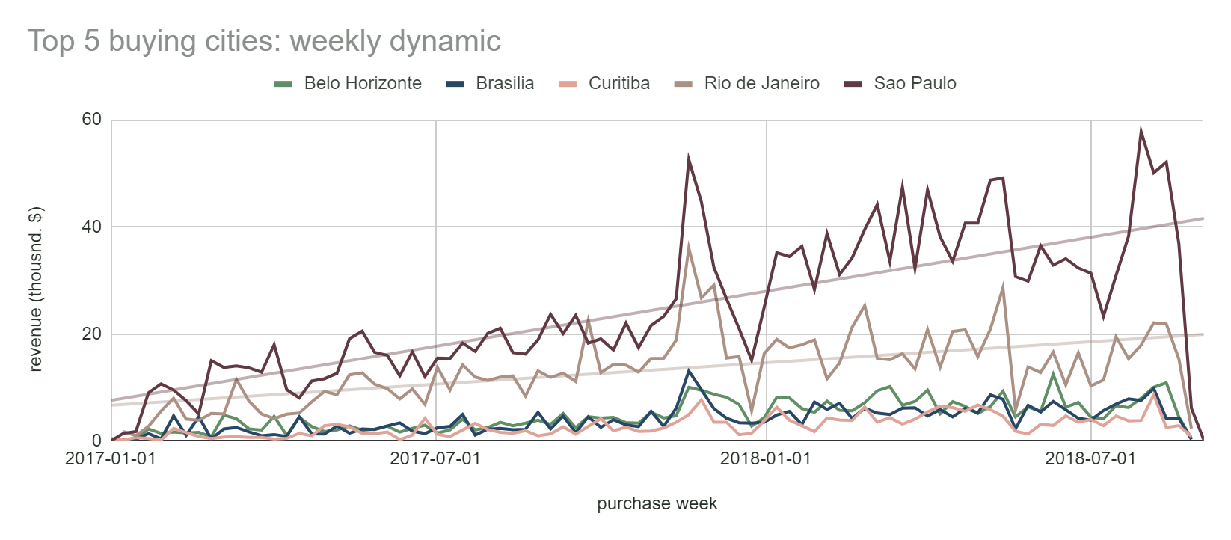
Top 5 buying cities represent the most populated (or close to the most populated cities) In Brazil.

Slide 10
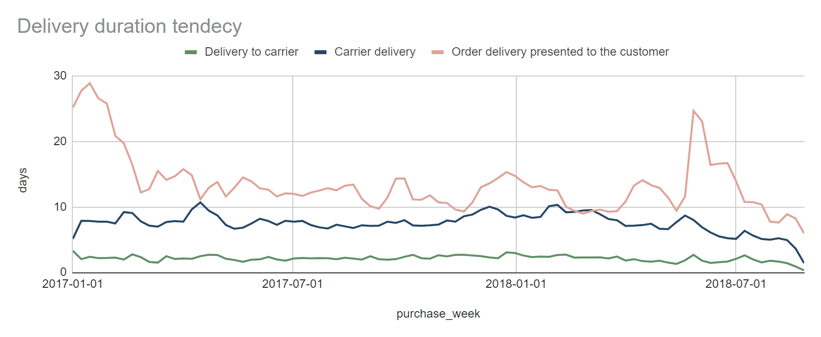
Currently delivery to the carrier takes ~2 days, that is not effective.
Recommended: improve the order process - 80% of the orders to be delivered <1 day.

Slide 11
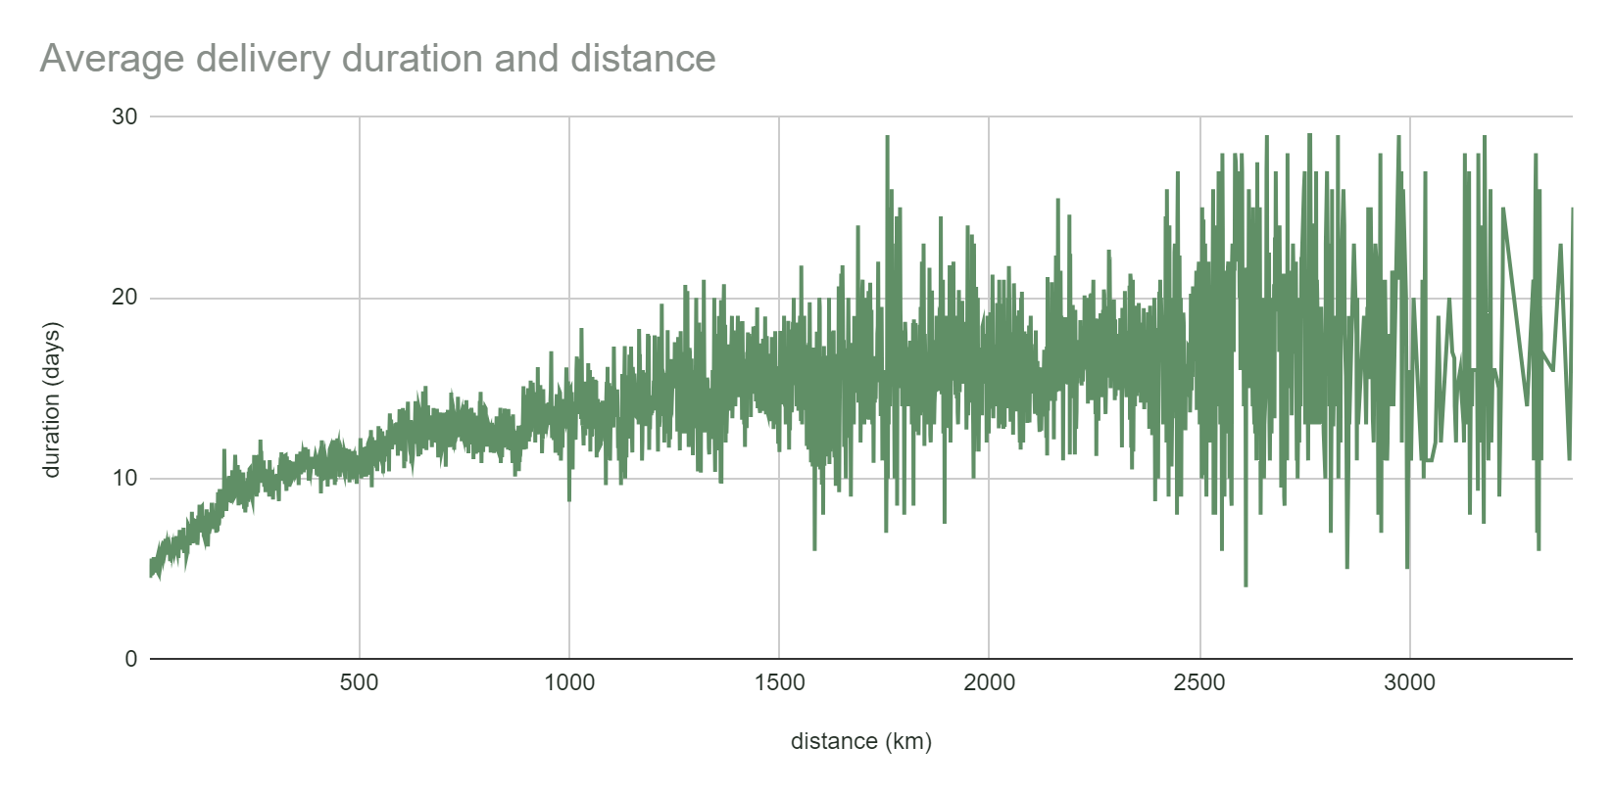
Shorter distances deliveries should be transferred in less than 3 working days.
Longer distances delivery should be optimized too.

Slide 12
Conclusions I
Avg. review score is high – product/shopping experience is well appreciated.
Average order value remains stable (~142$) with a slight tendency to decrease.
Customers have a higher tendency to buy more on Tuesday, Wednesday and Thursday. These days could be boosted with marketing campaigns and promotions. Saturday and Sunday are more successful in selling expensive orders.
Top 20% product categories generate 80% profit. It is recommended to focus on these products to boost the profitability.
Credit card offer an option to pay with many installments. Such option strengthens consumers’ purchasing power, and consequently boosts the average transaction value per customer.

Slide 13
Conclusions II
Customers needing attention >30%. Represents customers with low frequency, recency and monetary values. Strategy to win the attention - make limited time offers, recommend based on past purchases.
Top 5 buying cities represent the most populated (or close to the most populated cities) In Brazil. Main features: growing bying tendency, with a high peak reached in 2018 Black Friday and Mothers Day.
Costumers are providing their review about shopping experience, and smooth delivery is very important aspect.
Currently order approval takes ~10 h. Recommended to improve the order process to <1.
Currently delivery to the carrier takes ~2 d. Recommended to improve the order: < 1 d.
<250 km deliveries should be transferred in less than 3/4 working days.
>500 km delivery should be optimized too: using planes, which increases the average travel speed of a parcel.

